Slide 1
Foundation Models Preparing for the iPhone Moment in Medical Image Computing
MICCAI MedAGI, Marrakech, Morocco
October 6th, 2024
Mathias Unberath, PhD
John C. Malone Associate Professor
Department of Computer Science
Johns Hopkins University
Notes:
Start with the story about Jonathan and Sam being stung by bees and want to eradicate them
No other plants, no honey etc.
Ecosystem is acomplex interwoven system
Removing a component or adding one does not produce the most clear consequences
Same with technology

Slide 2

Thanks to Bing Image Creator running Dall-E3
2007: The iPhone moment
New technology resulting in profound transformation

Slide 3

Thanks to Bing Image Creator running Dall-E3
2022: The ChatGPT moment
→ New technology that transforms society!

Slide 4
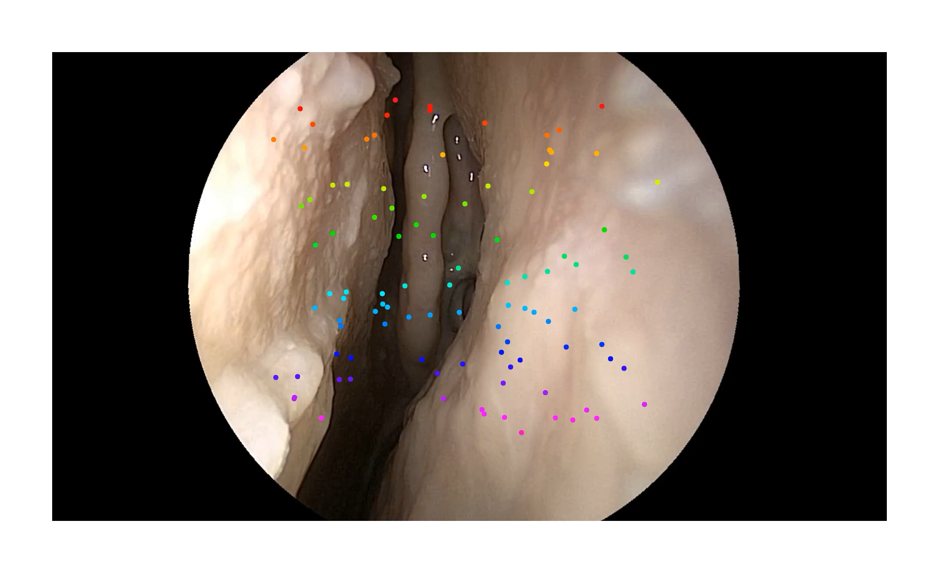
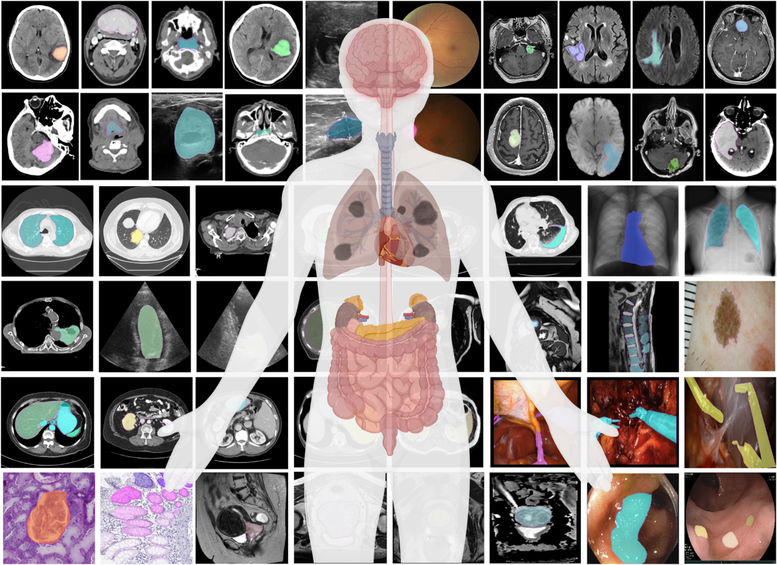
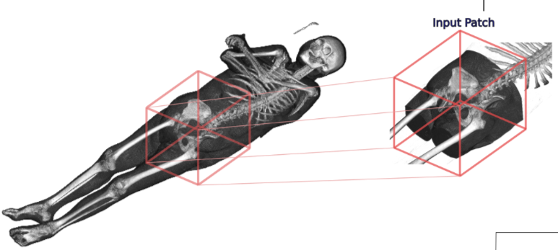
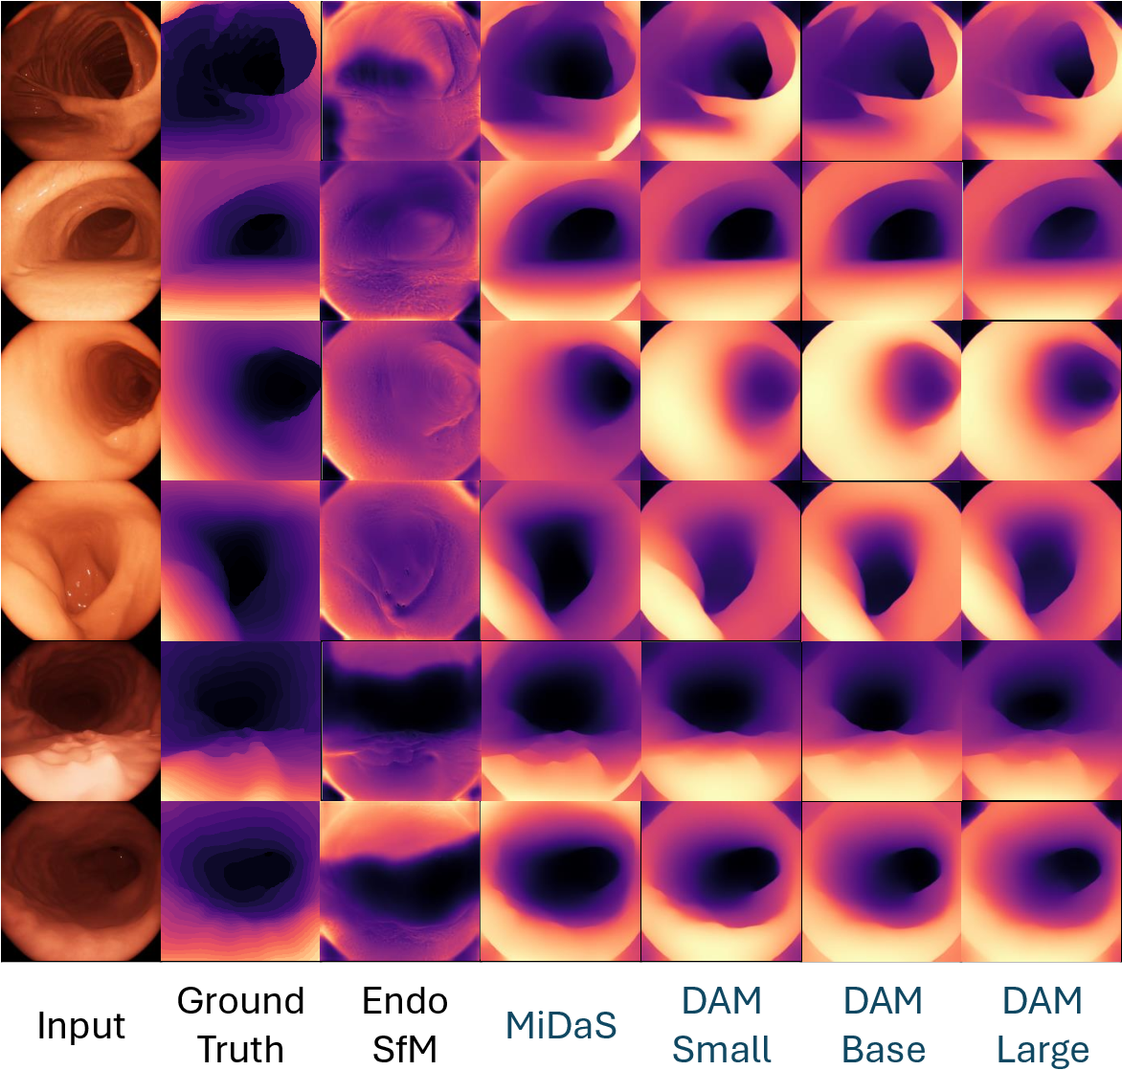
Foundation Models on the Rise
Tracking
Segmentation
Generation
Depth estimation
… and many more!

Slide 5
What makes foundation models different?
Formulated to solve “foundational tasks”
No uber-specific task definition
Building blocks rather than “complete” solutions

Slide 6
What makes foundation models different?
Formulated to solve “foundational tasks”
No uber-specific task definition
Building blocks rather than “complete” solutions
Flexibility enables scaling
Dataset mixing (→ no “semantics”)
Self-supervised learning

Slide 7
What makes foundation models different?
Formulated to solve “foundational tasks”
No uber-specific task definition
Building blocks rather than “complete” solutions
Flexibility enables scaling
Dataset mixing (→ no “semantics”)
Self-supervised learning
Scaling results in (better) generalization
Larger variety in training sets
Often: Applicable “out of the box” to new problem domains

Slide 8

Foundation Models – iPhone Moment for MIC?
Potential for catalytic effect in medical image computing and beyond
Flexible task formulations
→ Strong, generalizable building blocks
“Out of the box generalization”
→ Dramatically reduced dev. Costs
Potential for ubiquitous adoption of quantitative tools
Notes:
Primarily exist at the venues with highly specialized providers

Slide 9

Tracking Any Point
OneSLAM to Map Them All

Slide 10
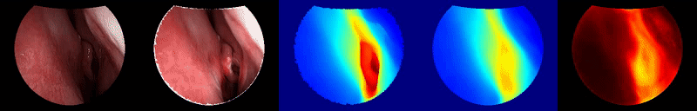
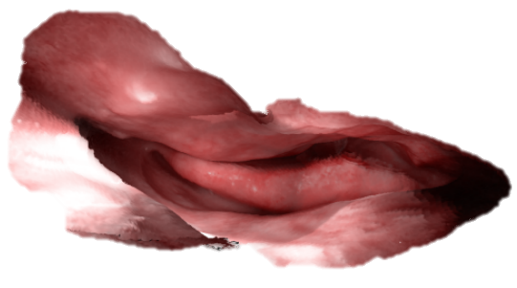
Quantitative Endoscopy
Endoscopy (and related modalities) is qualitative
Want: Endoscope tracking and reconstruction (SLAM)
Enables quantitative analysis
Persistent challenges for computer vision in endoscopy
Lack of photometric constancy (same looks different)
Scarce features, repetitive texture
Liu, X., Stiber, M., Huang, J., Ishii, M., Hager, G. D., Taylor, R. H., & Unberath, M. (2020). Reconstructing sinus anatomy from endoscopic video–towards a radiation-free approach for quantitative longitudinal assessment. In MICCAI 2020.

Slide 11
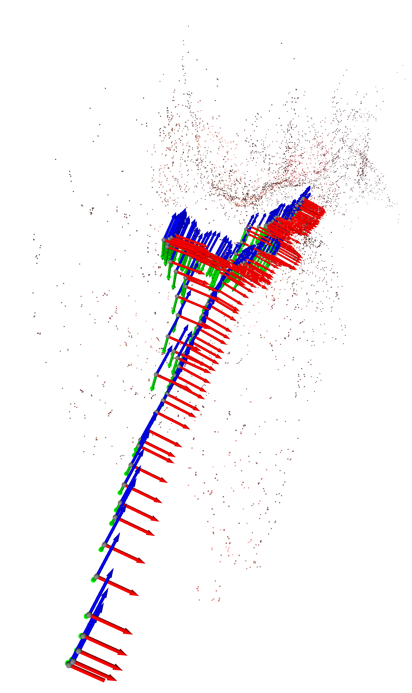
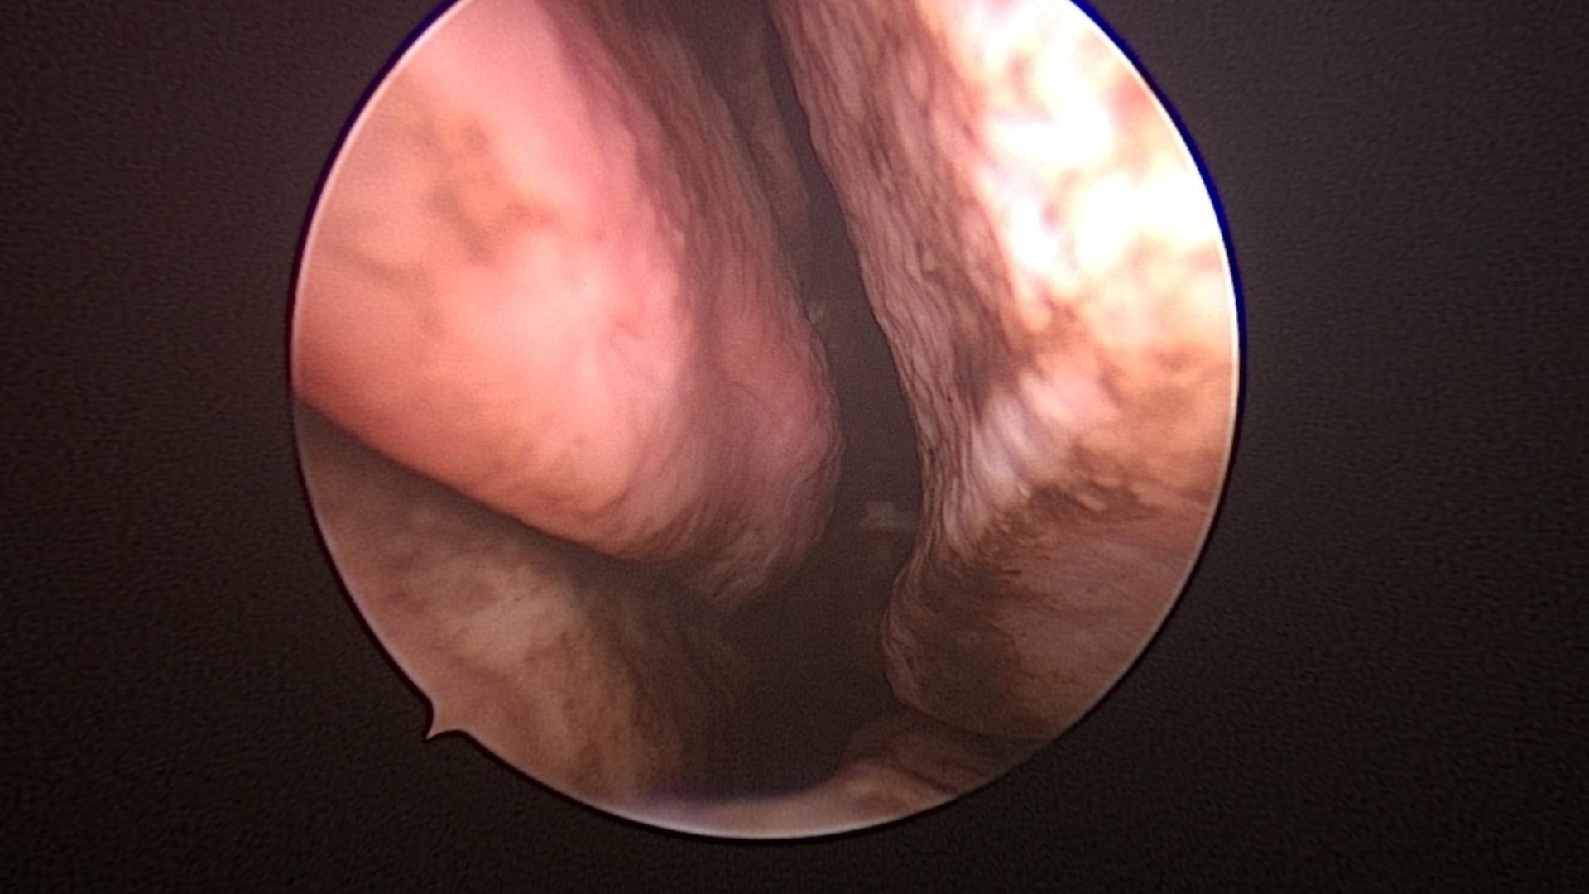
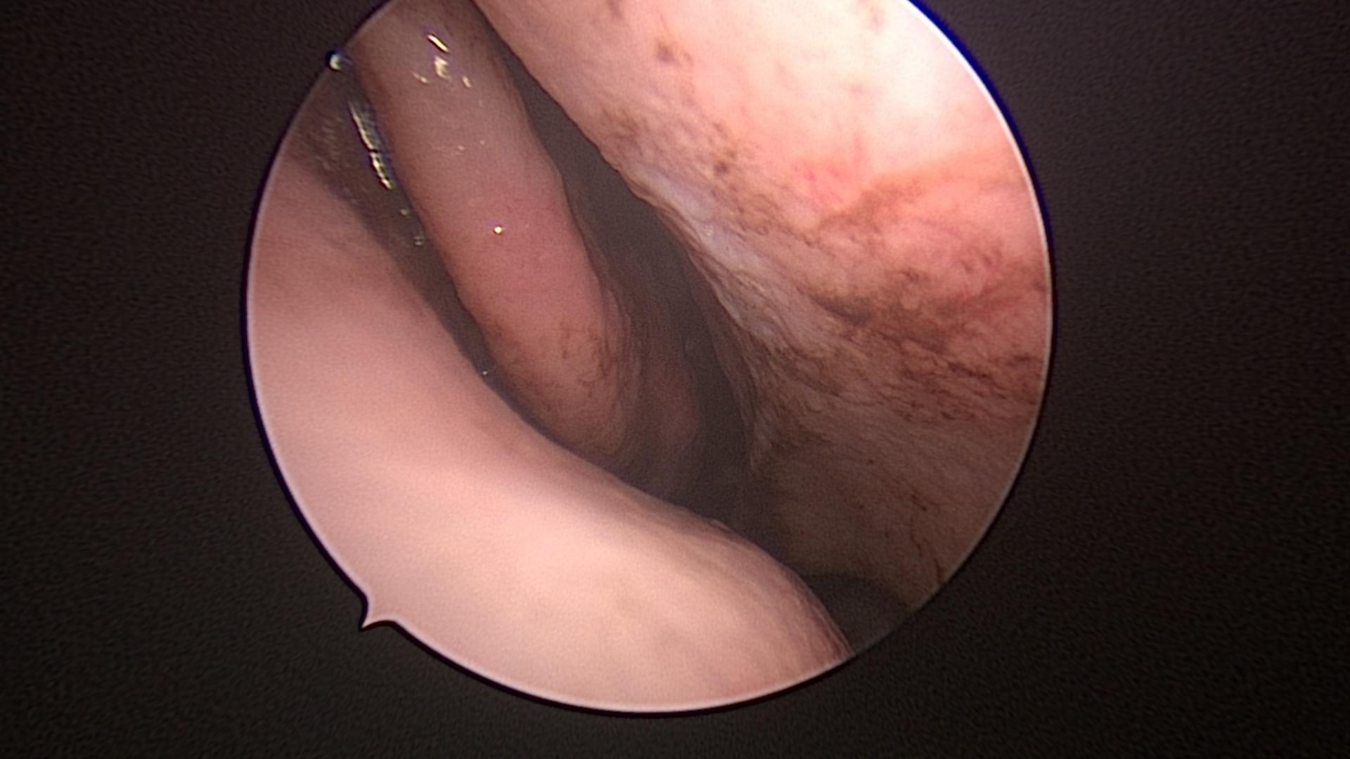
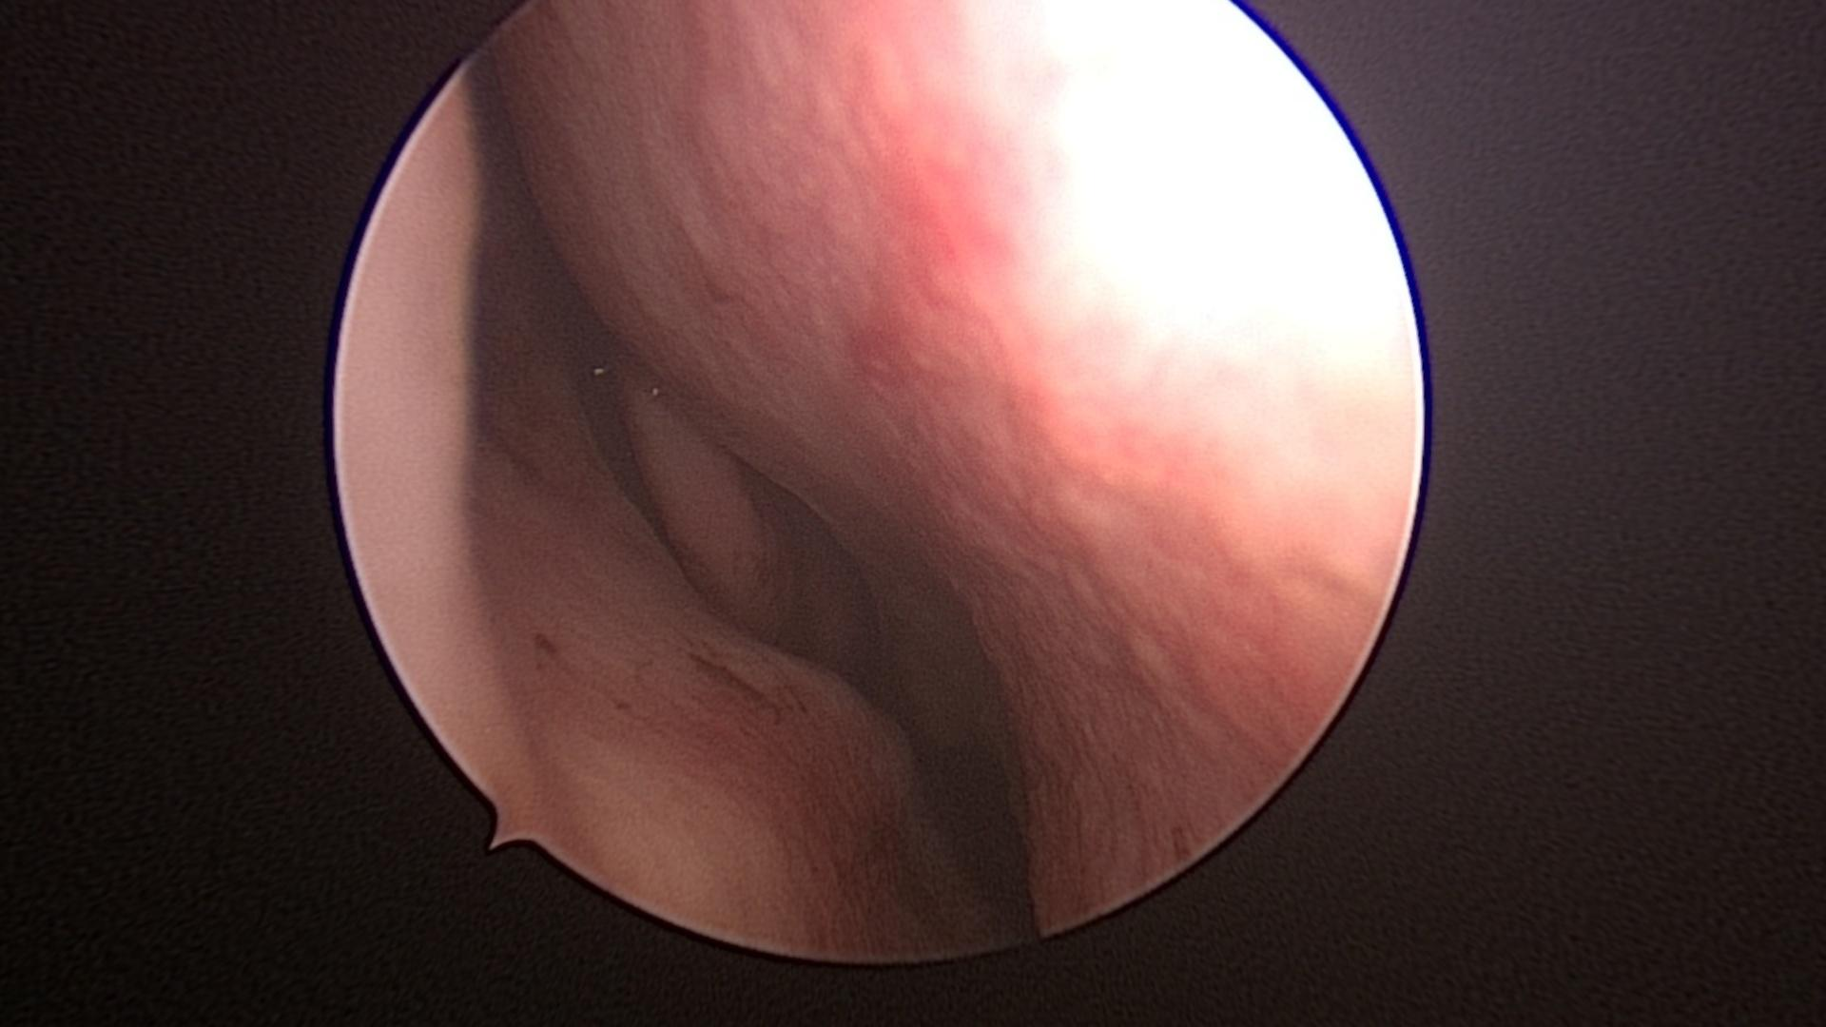
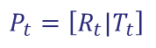
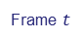
Opportunities for Foundation Models
Localization
Mapping
Frame-wise
Point Tracking
Section-wise
Point Tracking
Frame $t$
Machine Learning
Frame localization
Keyframe Decisions
Local Bundle Adjustment
Section full?
Sparse reconstruction &
Pose estimates
Highly specialized
Brittle solutions
→ Little flexibility
$$P_{t}=\left[R_{t}|T_{t}\right]$$
Current pose estimate
Liu, X., Zheng, Y., Killeen, B., Ishii, M., Hager, G. D., Taylor, R. H., & Unberath, M. (2020). Extremely dense point correspondences using a learned feature descriptor. In Proceedings of the IEEE/CVF conference on computer vision and pattern recognition (pp. 4847-4856).

Slide 12
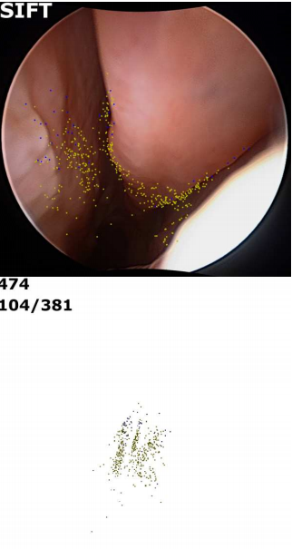



Opportunities for Foundation Models
Localization
Mapping
Frame-wise
Point Tracking
Section-wise
Point Tracking
Frame $t$
Frame localization
Keyframe Decisions
Local Bundle Adjustment
Section full?
Sparse reconstruction &
Pose estimates
$$P_{t}=\left[R_{t}|T_{t}\right]$$
Current pose estimate
Liu, X., Zheng, Y., Killeen, B., Ishii, M., Hager, G. D., Taylor, R. H., & Unberath, M. (2020). Extremely dense point correspondences using a learned feature descriptor. In Proceedings of the IEEE/CVF conference on computer vision and pattern recognition (pp. 4847-4856).

Slide 13
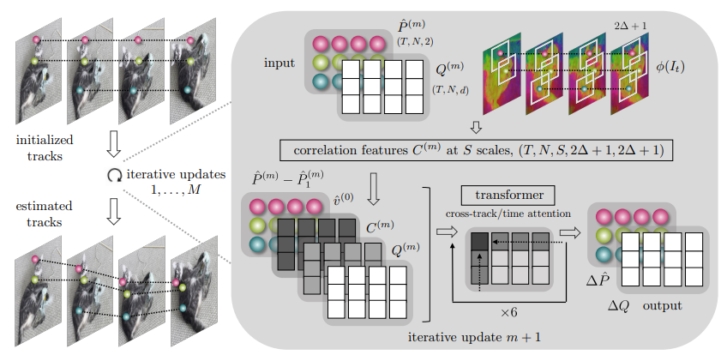
Tracking Any Point Foundation Models
Iteratively update point tracks of arbitrary points
Cross-track and cross-time attention
Modern, transformer-based architecture
Karaev, N., Rocco, I., Graham, B., Neverova, N., Vedaldi, A., Rupprecht, C.: Cotracker: It is better to track together. arXiv:2307.07635 (2023)​

Slide 14
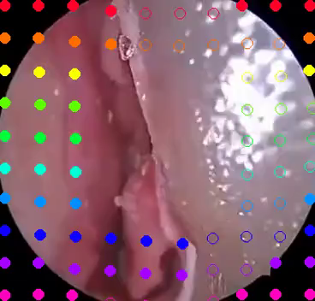
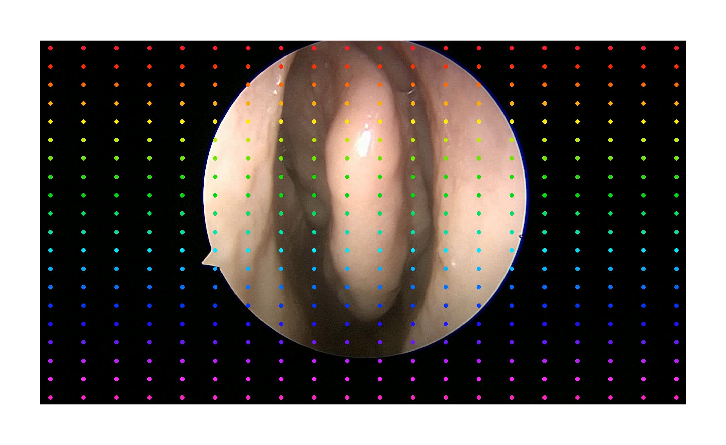
Tracking Any Point Foundation Models
Iteratively update point tracks of arbitrary points
Cross-track and cross-time attention
Modern, transformer-based architecture
Seenivasan, L., …, Unberath, M.: Tracking Any Point Foundation Models for Endoscopic Applications, 2024. In Preparation.

Slide 15
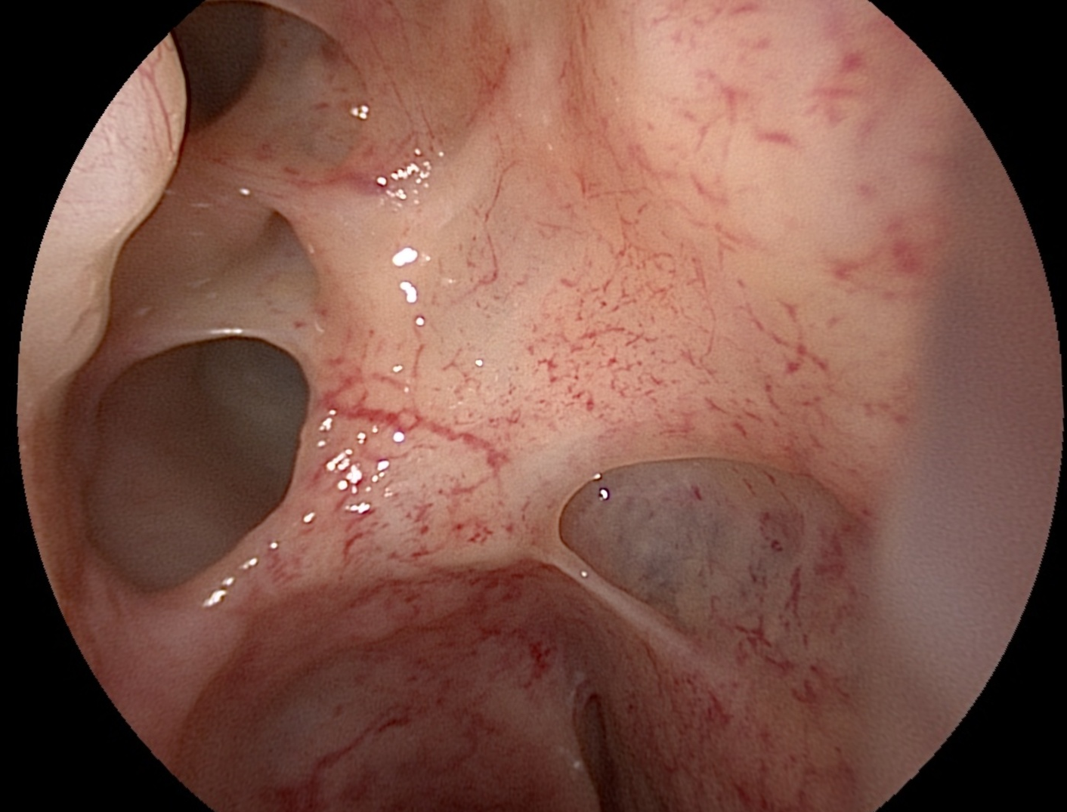
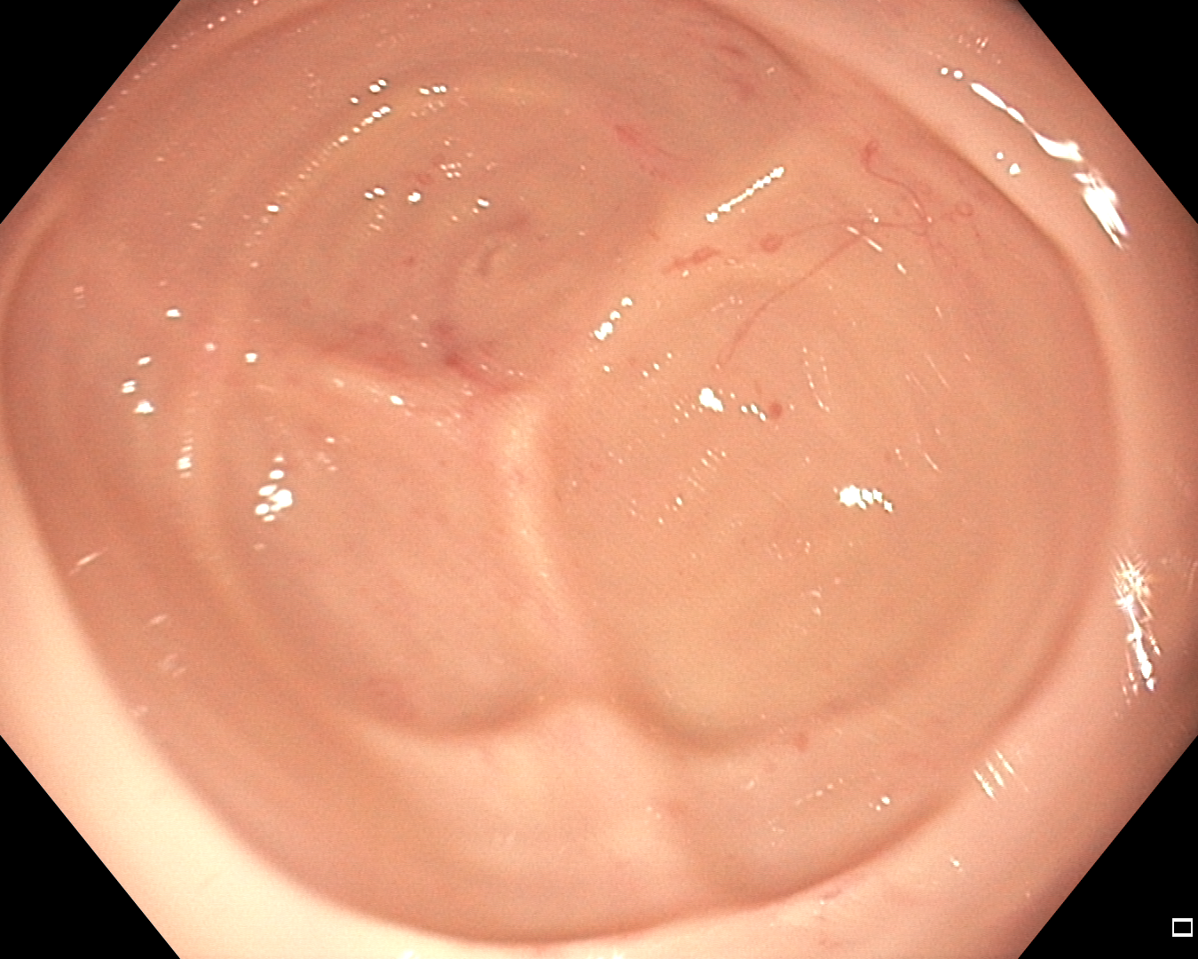
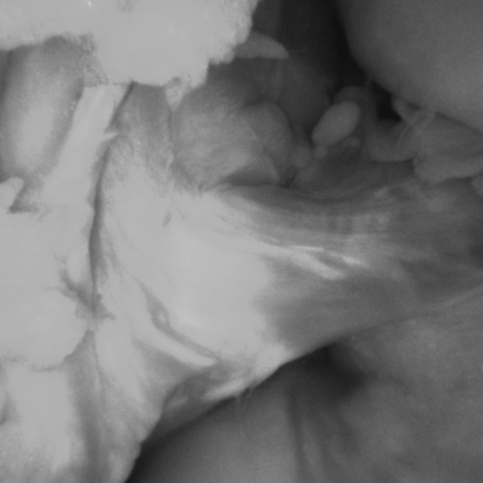
SLAM using Tracking Any Point Foundation Models
OneSLAM based on Tracking Any Point Foundation Model
First FM-based SLAM (at least for endoscopy)
Outperforms both: Conventional approaches & domain-specific ML methods
Teufel, T., Shu, H.,... & Unberath, M. (2024). OneSLAM to map them all: a generalized approach to SLAM for monocular endoscopic imaging based on tracking any point. IPCAI, 1-8.

Slide 16
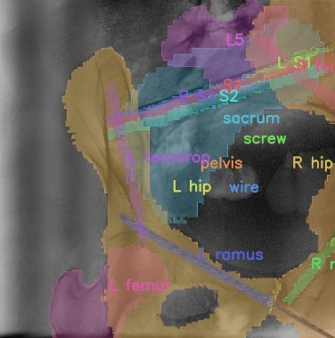
Segmenting Anything
FastSAM3D and ProtoSAM3D

Slide 17
Segment Anything Models (SAM)
Segmentation is a key enabling task
“Making sense” of medical images
Enables quantitative analysis
Foundation models for segmentation
Replace semantics with user query
Interactivity ←→ Generalization
Two challenges
Scaling SAM to volumetric images
Clawing back semantic segmentation benefits
Notes:
HOW DO YOU MAKE truly interactive

Slide 18
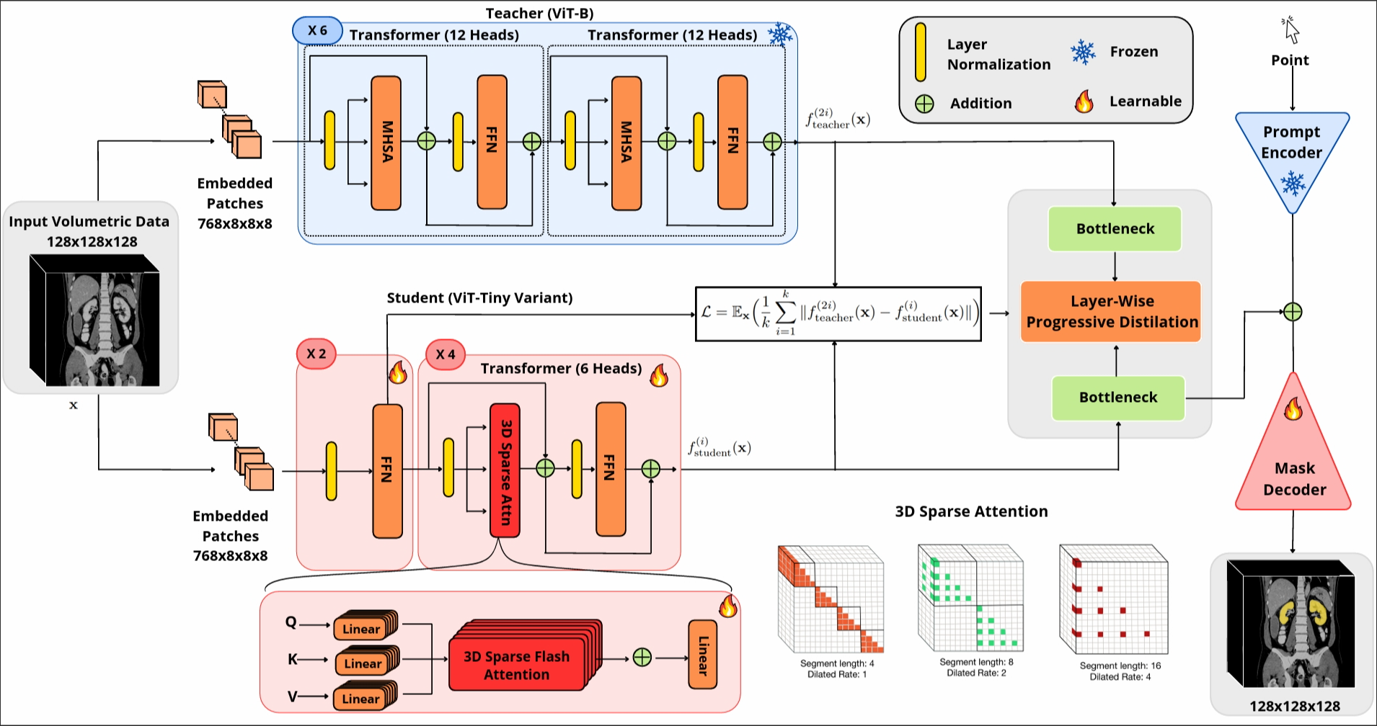
Scaling SAM to High-resolution Volumes
Iteratively update point tracks of arbitrary points
Layer-wise progressive distillation to a VIT-Tiny
3D sparse flash attention
Shen, Y., Li, J., Shao, X., Romillo, B. I., Jindal, A., Dreizin, D., & Unberath, M. (2024). FastSAM3D: An Efficient Segment Anything Model for 3D Volumetric Medical Images. MICCAI.

Slide 19
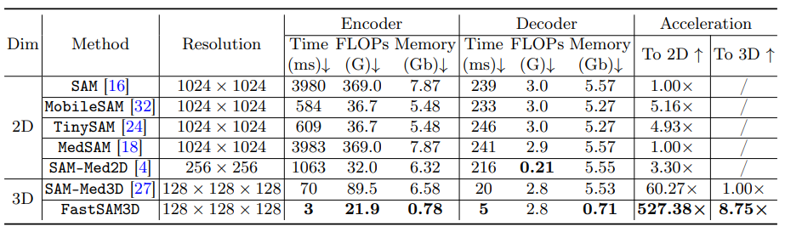
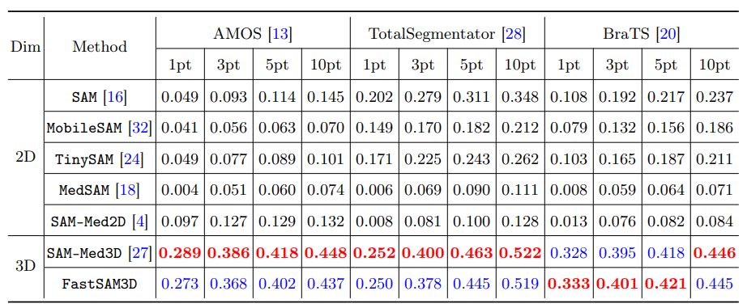
FastSAM3D
Convincing performance (for SAM models)
Best or second-best performance across several benchmarks
3ms execution! >500x / >8x speed-up compared to 2D / 3D methods
Shen, Y., Li, J., Shao, X., Romillo, B. I., Jindal, A., Dreizin, D., & Unberath, M. (2024). FastSAM3D: An Efficient Segment Anything Model for 3D Volumetric Medical Images. MICCAI.

Slide 20
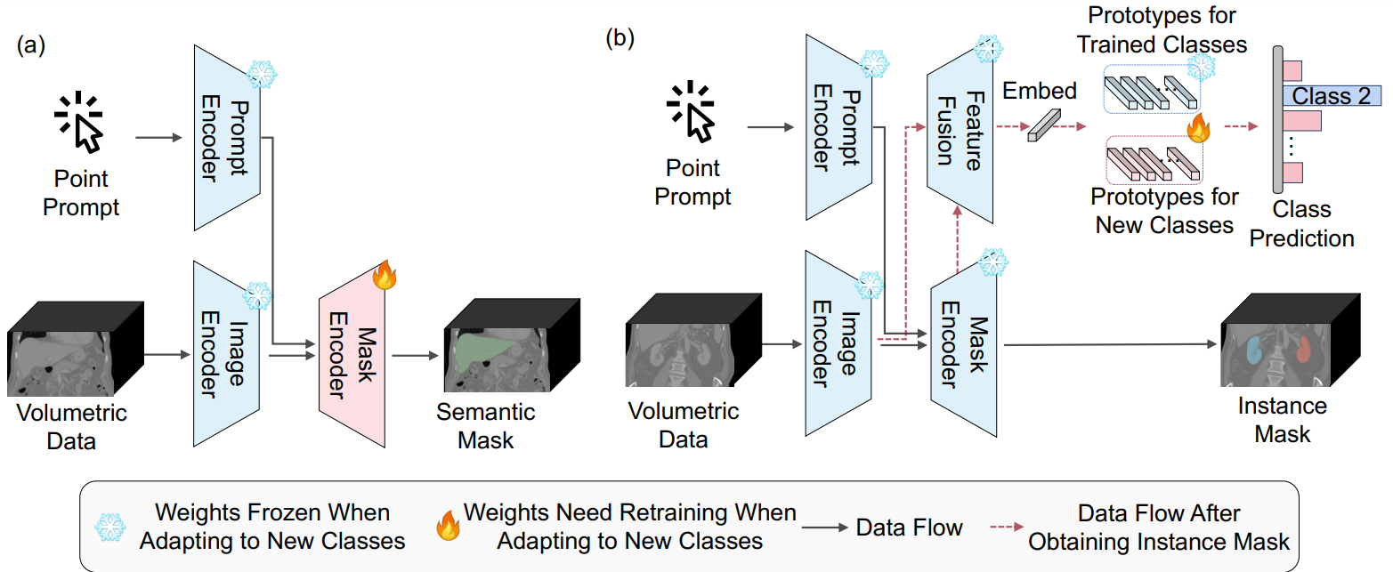
Leveraging the Best of Both Worlds – ProtoSAM3D
Automated semantic segmentation while retaining SAM’s flexibility
Two-stages: 1) Coarse prototype identification; 2) Fine segmentation
Prompting still possible! New prototypes can be added anytime!
Shen, Y., Dreizin, D., Inigo Romillo, B., & Unberath, M. (2024). ProtoSAM3D: Interactive Semantic Segmentation in Volumetric Medical Imaging via a Segment Anything Model and Mask-Level Prototypes. Under review.

Slide 21
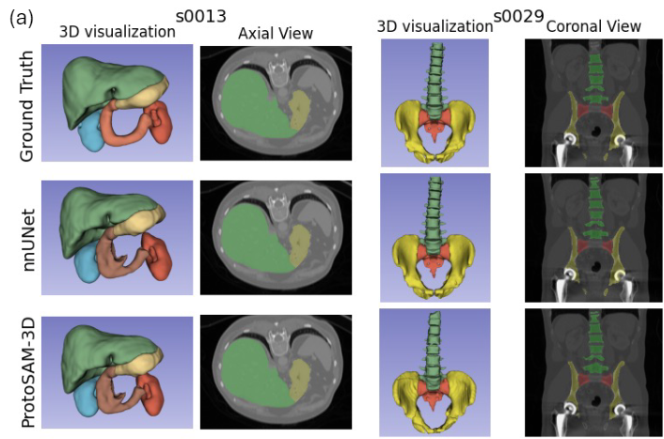
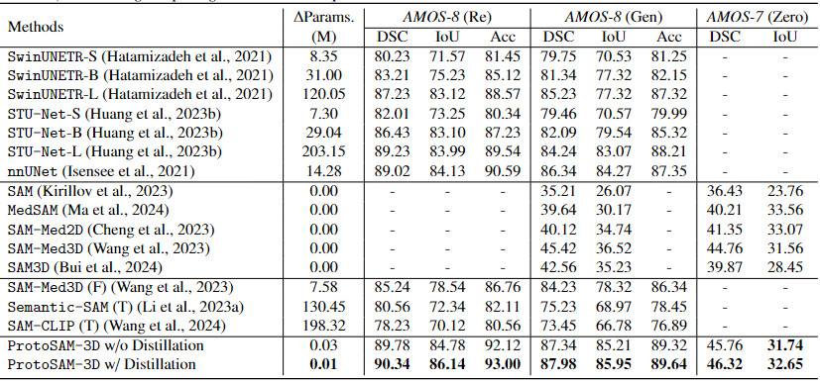
Leveraging the Best of Both Worlds – ProtoSAM3D
Automated semantic segmentation while retaining SAM’s flexibility
Convincing qualitative and quantitative performance
Among first models for semantic and zero-shot instance segmentation
Shen, Y., Dreizin, D., Inigo Romillo, B., & Unberath, M. (2024). ProtoSAM3D: Interactive Semantic Segmentation in Volumetric Medical Imaging via a Segment Anything Model and Mask-Level Prototypes. Under review.

Slide 22
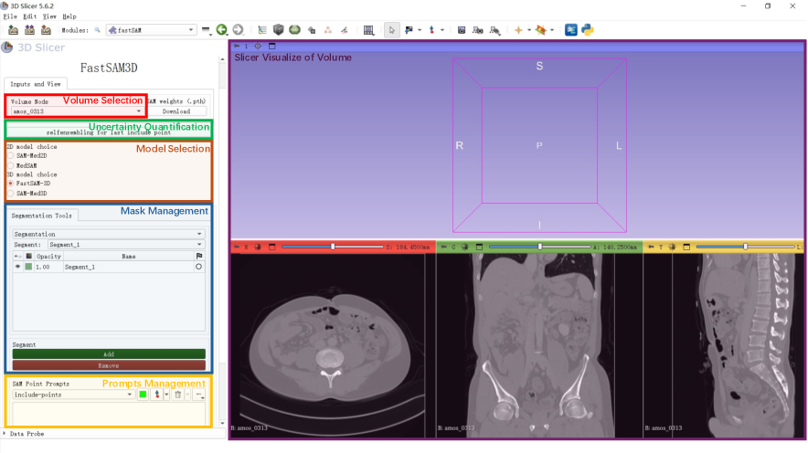

3DSlicer Interface for 2D and 3D SAM
Shen, Y., Shao, X., Romillo, B. I., Dreizin, D., & Unberath, M. (2024). FastSAM-3DSlicer: A 3D-Slicer Extension for 3D Volumetric Segment Anything Model with Uncertainty Quantification. MICCAI MedAGI Workshop.

Slide 23
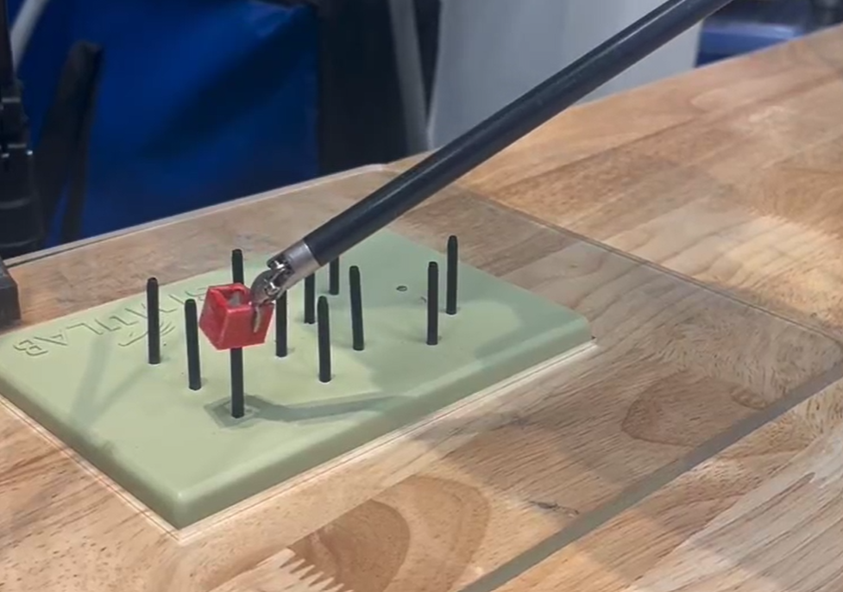
Robot Automation
Catalytic Potential of Foundation Models as Building Blocks

Slide 24
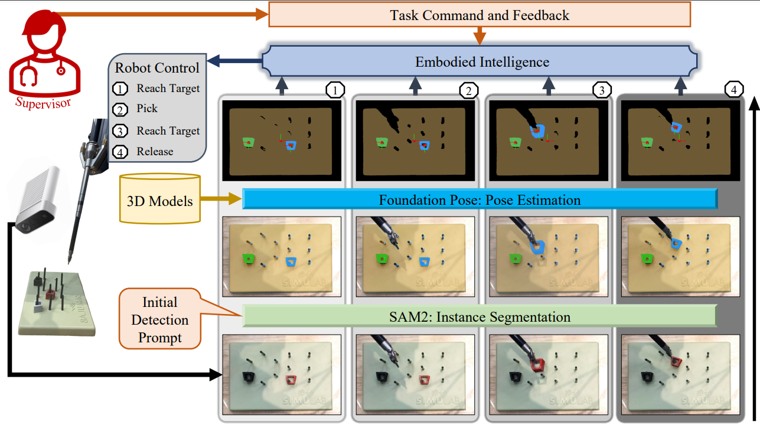

Slide 25
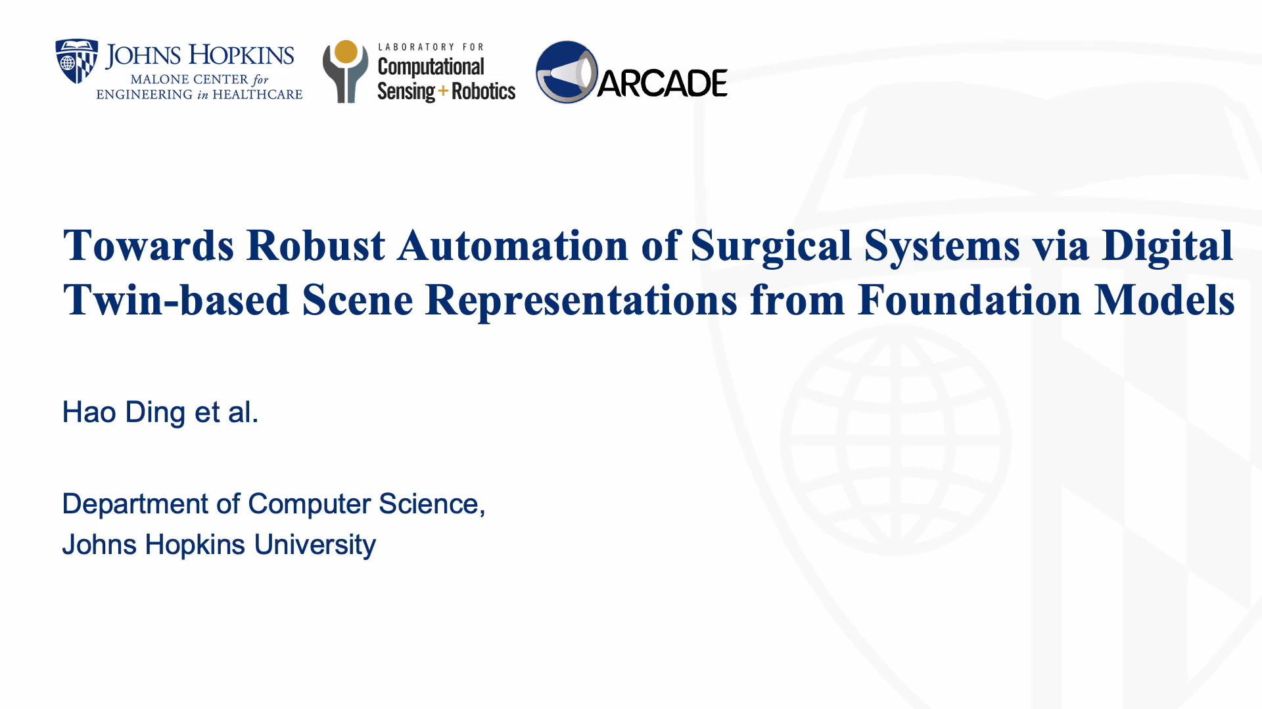

Slide 26
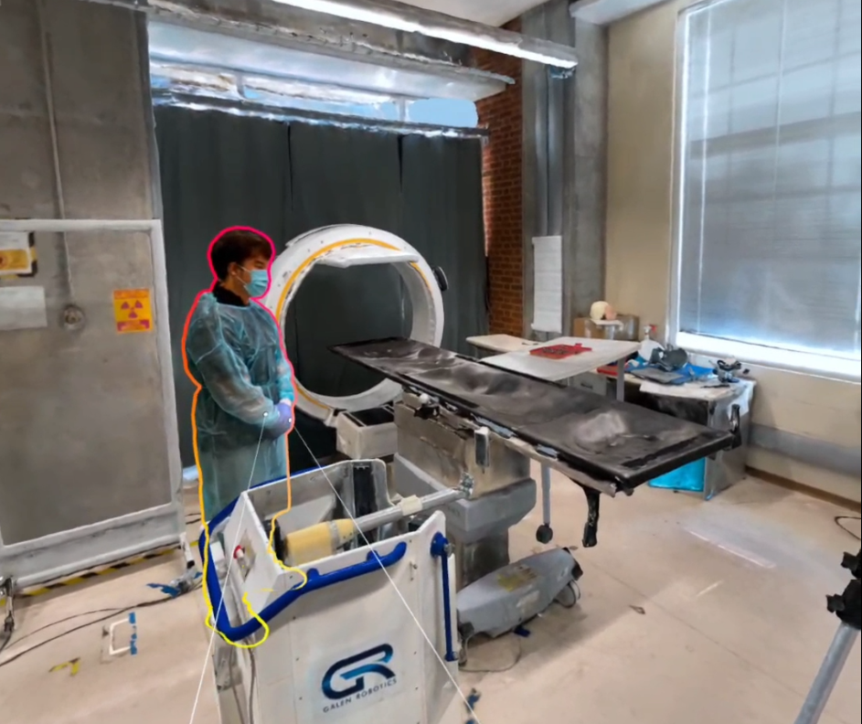
Concluding Thoughts
Towards an iPhone Moment in Medical Image Computing

Slide 27
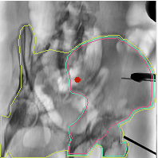
Foundation Models for Medical Image Computing
This is the beginning – not the end!
Movement towards foundation models is young
Many open challenges
Opportunities and open problems
Data – Flexibility helps but not always sufficient
Flexible problem formulations and task design to enable scaling
Many reasons for optimism and excitement!
High accessibility
Transformational impact on MIC and precision healthcare
Notes:
Primarily exist at the venues with highly specialized providers

Slide 28

Thank you.
Questions, comments? Ask now or email me at: mathias@jhu.edu

